Slide 1

Agentic AI Builder: Low-Code AI Agents & Voice Agents in n8n
Week 2
Day 4

Slide 2
3 Weeks to Agentic AI Builder
Core skills
Integrations
Projects
Week 3: Amplify with multi-agent systems and MCP
Self-hosted n8n and Local LLMs
Advanced Integrations
MCP
Context Engineering, Sub-Agents
Capstone: Amplify your business
Week 2: Accelerate with Voice Agents and RAG
Voice Agents with ElevenLabs
Integrating ElevenLabs and n8n
RAG and Agentic RAG
Supabase Vectors and Data ingest
Product Expert Voice Agent
Week 1: Automate with workflows in n8n cloud
First n8n AI Agent Live
Foundations: Agentic AI and n8n
Integrations with docs and email
Data and integrations
Daily Portfolio Rebalancer

Slide 3



Recap: RAG
Give LLMs expertise by adding information to the prompt
Make your LLM more knowledgeable
“Retrieval Augmented Generation” is a clever trick that works well
Small idea: simply add information to the Prompt
“Here is some context that you might find useful in answering the question”
Big idea: a trick to get a relevant subset of data
And use an LLM to do it

Slide 4
Recap: The Embedding Model
A special kind of LLM that turns language into numbers
Outputs a list of numbers (“vector”) to represent text
Can think of it as a point in space
Text with similar numbers represent similar things
“Close to each other in vector space”
This gives us an elegant way to do a fuzzy search
“Semantic Search”: find text with vectors that are close by

Slide 5




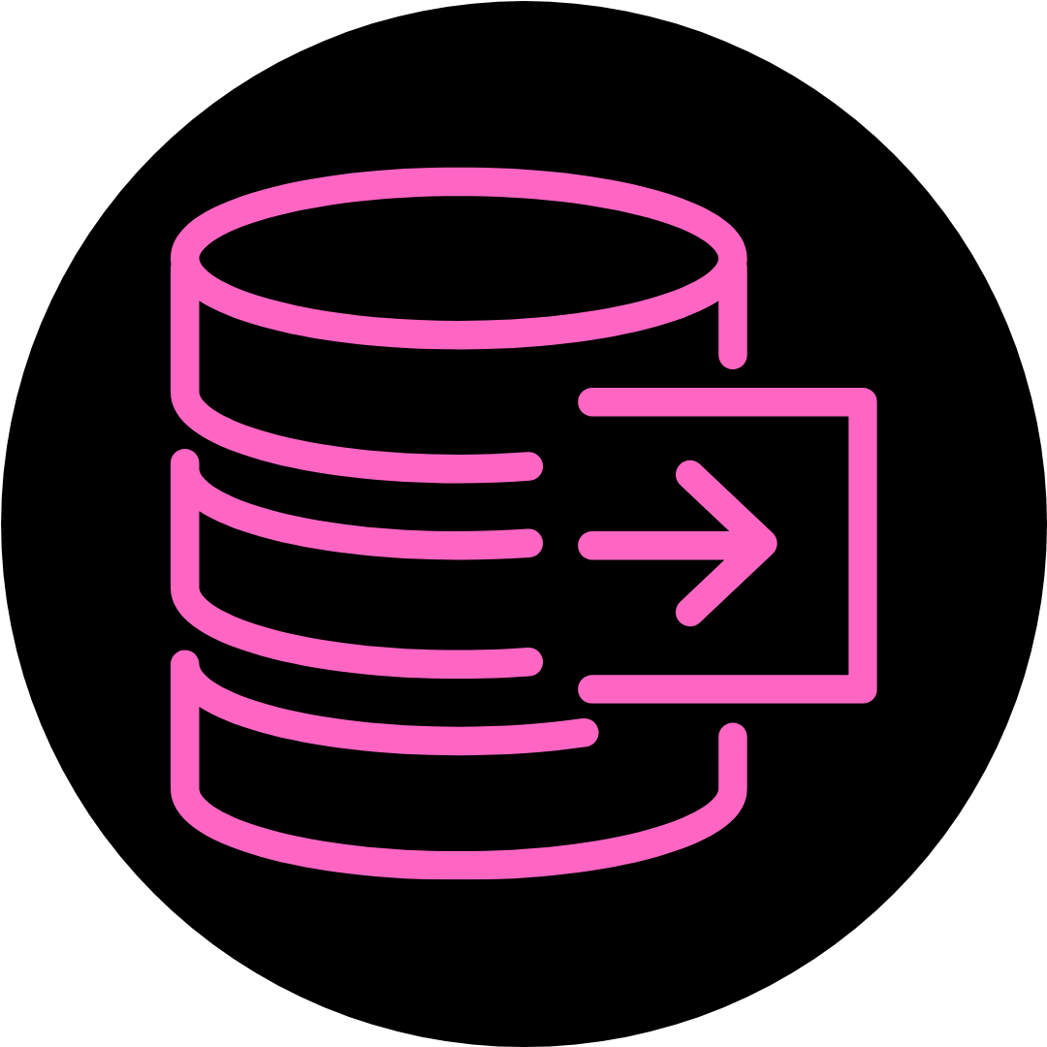
The big idea behind RAG
Embedding LLM
Vectorize
Question
Prompt
Answer
Response
Chat
n8n
LLM
Retrieve
Vector Datastore

Slide 6
RAG vs Agentic RAG
Traditional RAG
Chat
Vector-
based
Retrieval
LLM
(response)
Agentic RAG
Chat
Agent
LLM (workflow & response)
Vector-
based
Retrieval
More retrieval
tools

Slide 7
Two Phases of RAG
Data Ingest
Extract
Trans-
form
Chunk &
Vectorize
Load
Data
Source
Vector Store
RAG pipeline / Question Answering
Chat
Agent
LLM (workflow & response)
Vectorize
Vector Store

Slide 8
Business Challenge
Absolutely classic business setup:
Build an Expert to answer in-depth questions for your client. The client has a number of products in a massive Google sheet
For our solution we will use Supabase:
A popular cloud provider of Postgres databases.
More advanced than using the Simple Vector databases built into n8n, and there some code to copy & paste.
Today we focus on Data Ingest:
Interesting work: mapping the data from one format to another using the Edit Fields node.
Shortcut: we will use Google Sheet for product data. Next week, you’ll have skills to monitor a shared folder and ingest all files.
Then tomorrow we add Agentic RAG.. and Voice Agent!

Slide 9
3 Weeks to Agentic AI Builder
Core skills
Integrations
Projects
Week 3: Amplify with multi-agent systems and MCP
Self-hosted n8n and Local LLMs
Advanced Integrations
MCP
Context Engineering, Sub-Agents
Capstone: Amplify your business
Week 2: Accelerate with Voice Agents and RAG
Voice Agents with ElevenLabs
Integrating ElevenLabs and n8n
RAG and Agentic RAG
Supabase Vectors and Data ingest
Product Expert Voice Agent
Week 1: Automate with workflows in n8n cloud
First n8n AI Agent Live
Foundations: Agentic AI and n8n
Integrations with docs and email
Data and integrations
Daily Portfolio Rebalancer

Slide 10

Agentic AI Builder: Low-Code AI Agents & Voice Agents in n8n
60%
Complete

